Slide 1

Spotify Recommender System
By Bryce Forrest and Raymond Visconti
https://logodownload.org/wp-content/uploads/2016/09/Spotify-logo-13.jpg

Slide 2
Spotify
The Goal
Spotify is an online music streaming service
It generates recommended songs and playlists based on a user’s listening preferences
As of 2023, it boasts 574 million users, and over 100 million songs
Using Spotify playlist and song data, generate recommendations for similar songs

Slide 3
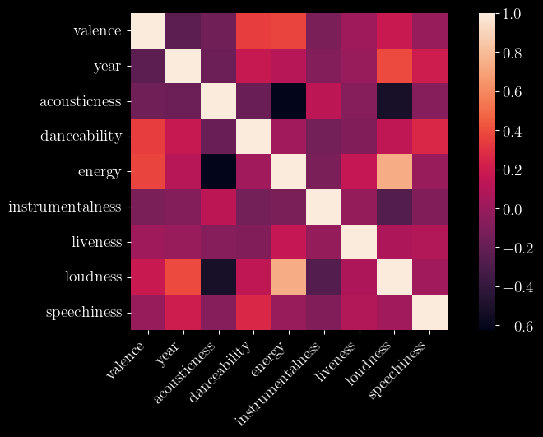
The Data
Spotify 1.2M+ Songs Dataset
Contains song features generated by Spotify’s web API
Features include acousticness, danceability, energy, explicit, instrumentalness, key, liveness, loudness, mode, popularity, speechiness, tempo, valence, and year
Spotify Million Playlist Dataset
JSON formatted playlists, containing playlist names, track IDs, and limited song information

Slide 4
Merging the Data
The tracks in the playlist dataset and the track metadata dataset each have a track ID associated with them
Join the two datasets on the intersection of track IDs
Resulting dataset gives track features within each playlist

Slide 5
Using Confidence Intervals to Recommend Songs
The function analyze_playlist starts by computing basic statistics (like mean and standard deviation) for each feature of the songs in the playlist.
For each feature, a confidence interval is calculated. This interval is defined as the range from mean - 0.5 * std to mean + 0.5 * std, where mean is the average value of the feature in the playlist and std is the standard deviation. This interval represents a range within which the majority of the features values lie for the songs in the playlist.
The confidence intervals serve to capture the "essence" or "character" of the playlist. If a song's features fall within these intervals, it suggests the song is similar in character to those in the playlist.

Slide 6
Scoring Mechanism
The scoring mechanism is used to evaluate how well a song matches the playlist profile:
Feature Comparison: For each feature (like tempo, loudness, etc.), the function song_fits_playlist checks if the song's value for that feature falls within the playlist's confidence interval for the same feature.
Scoring: Each time a song's feature value falls within the interval, the song scores a point.
Threshold and Fit: The song is considered a fit for the playlist if it scores above a certain threshold (defined by the threshold parameter). This threshold determines how strict the matching criteria are. A higher threshold means the song must match more closely to the playlist's profile to be considered a fit.

Slide 7
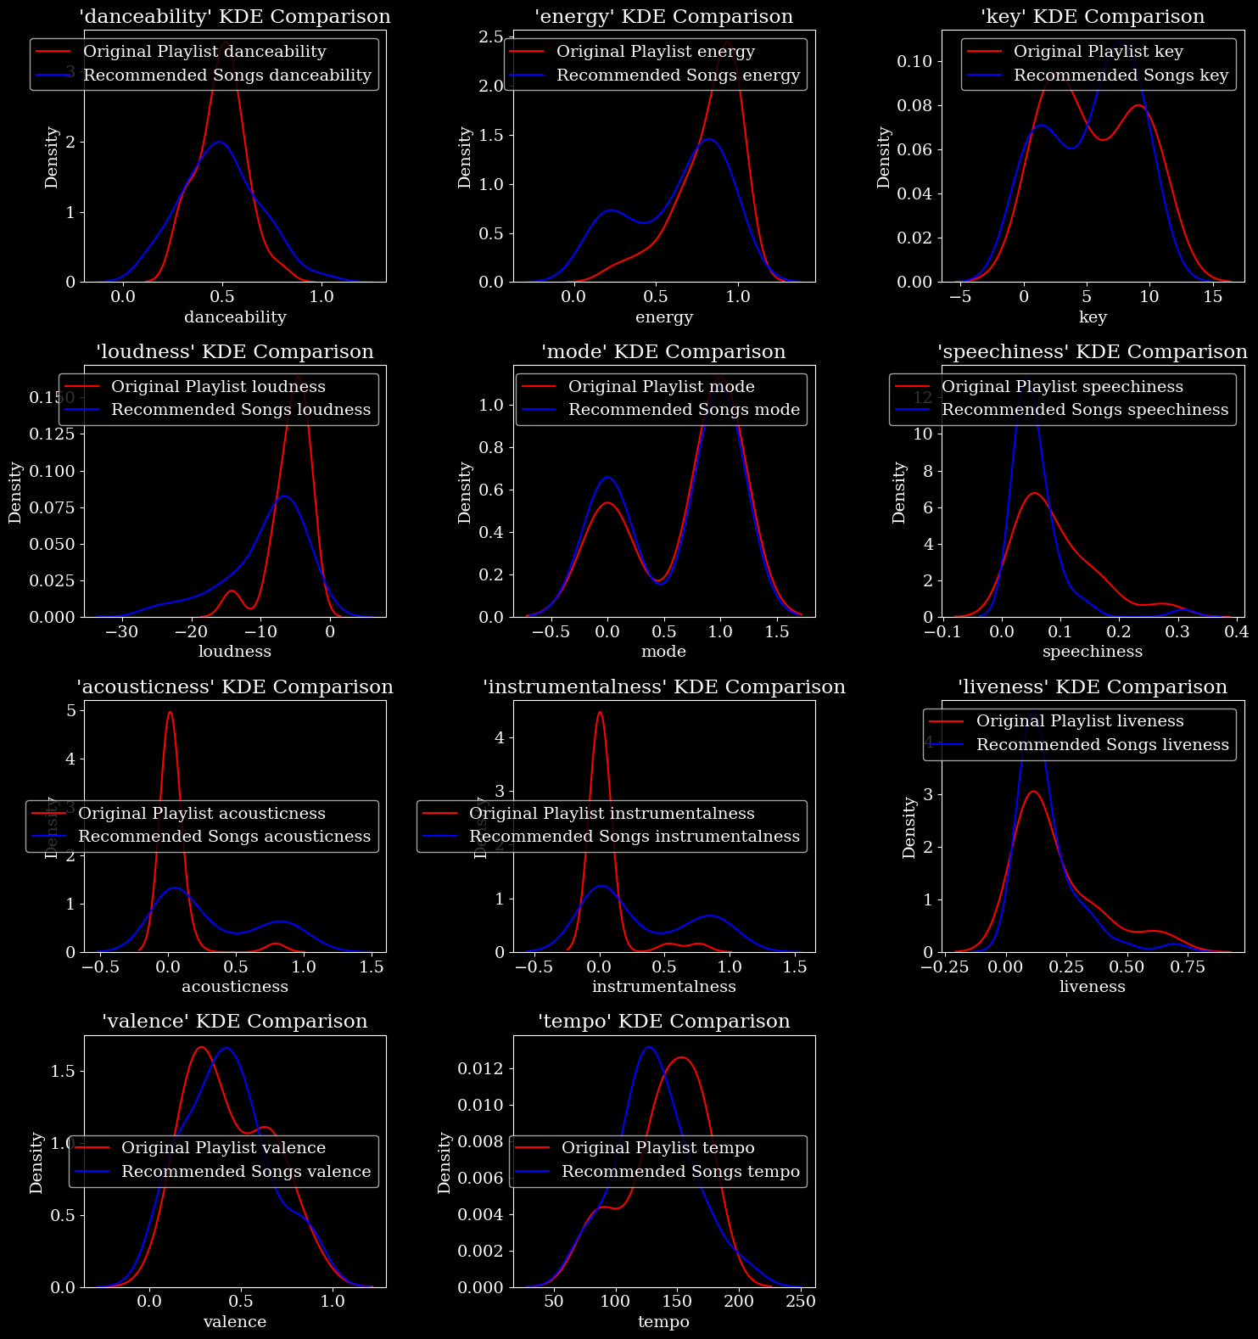
Rap Distributions

Slide 9
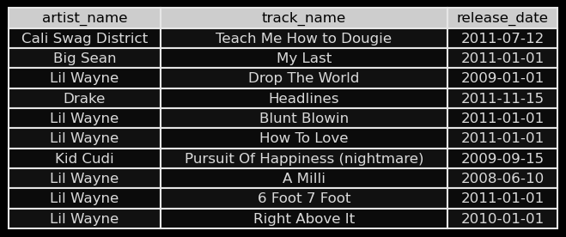
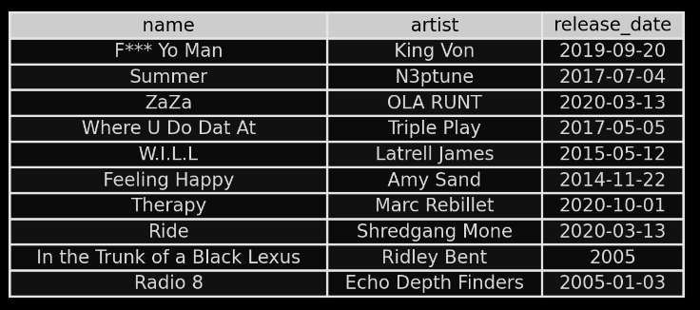
Sample of Rap Playlist
Sample of Rap Playlist Recommendations

Slide 10
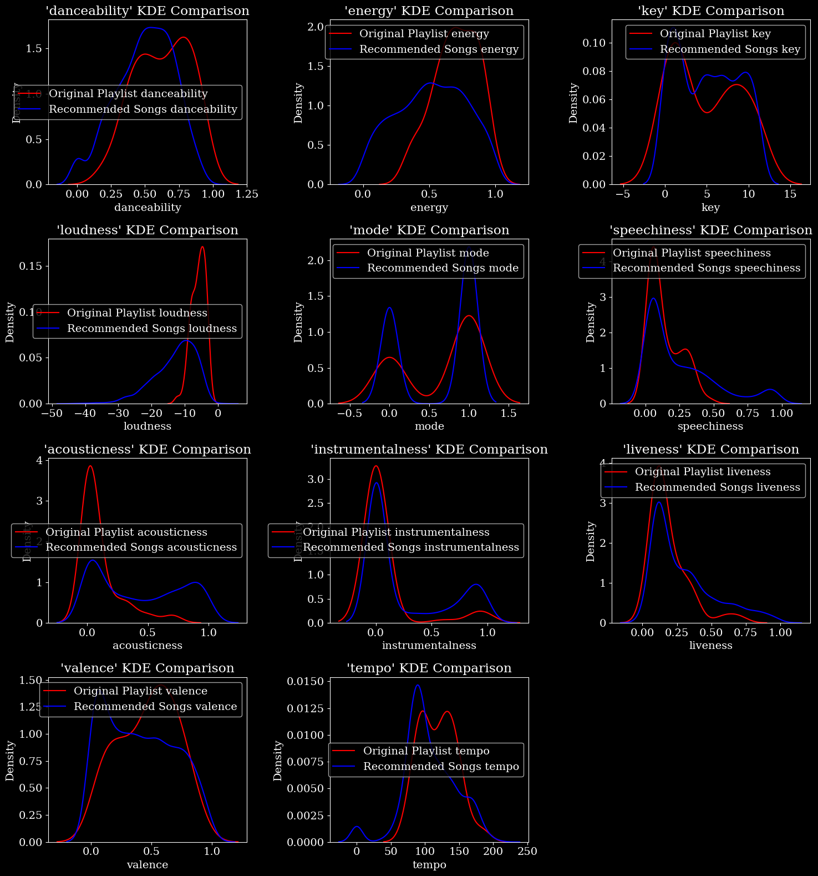
Gym Distributions

Slide 12
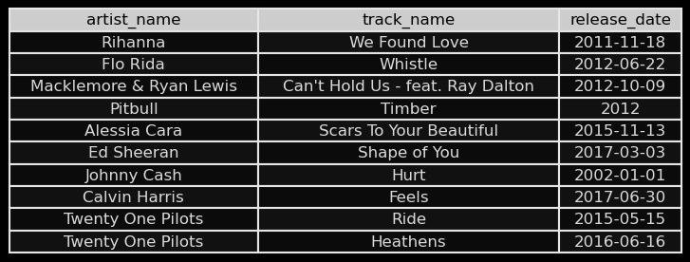
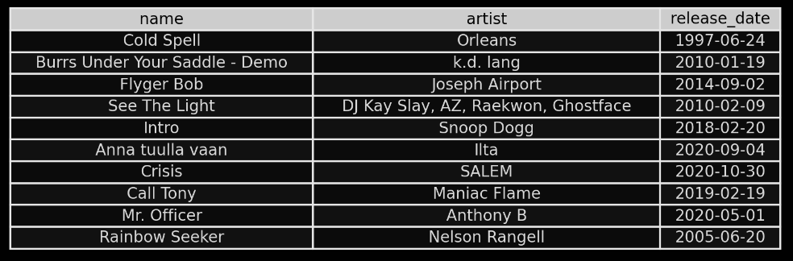
Sample of Gym Playlist
Sample of Gym Playlist Recommendations

Slide 13
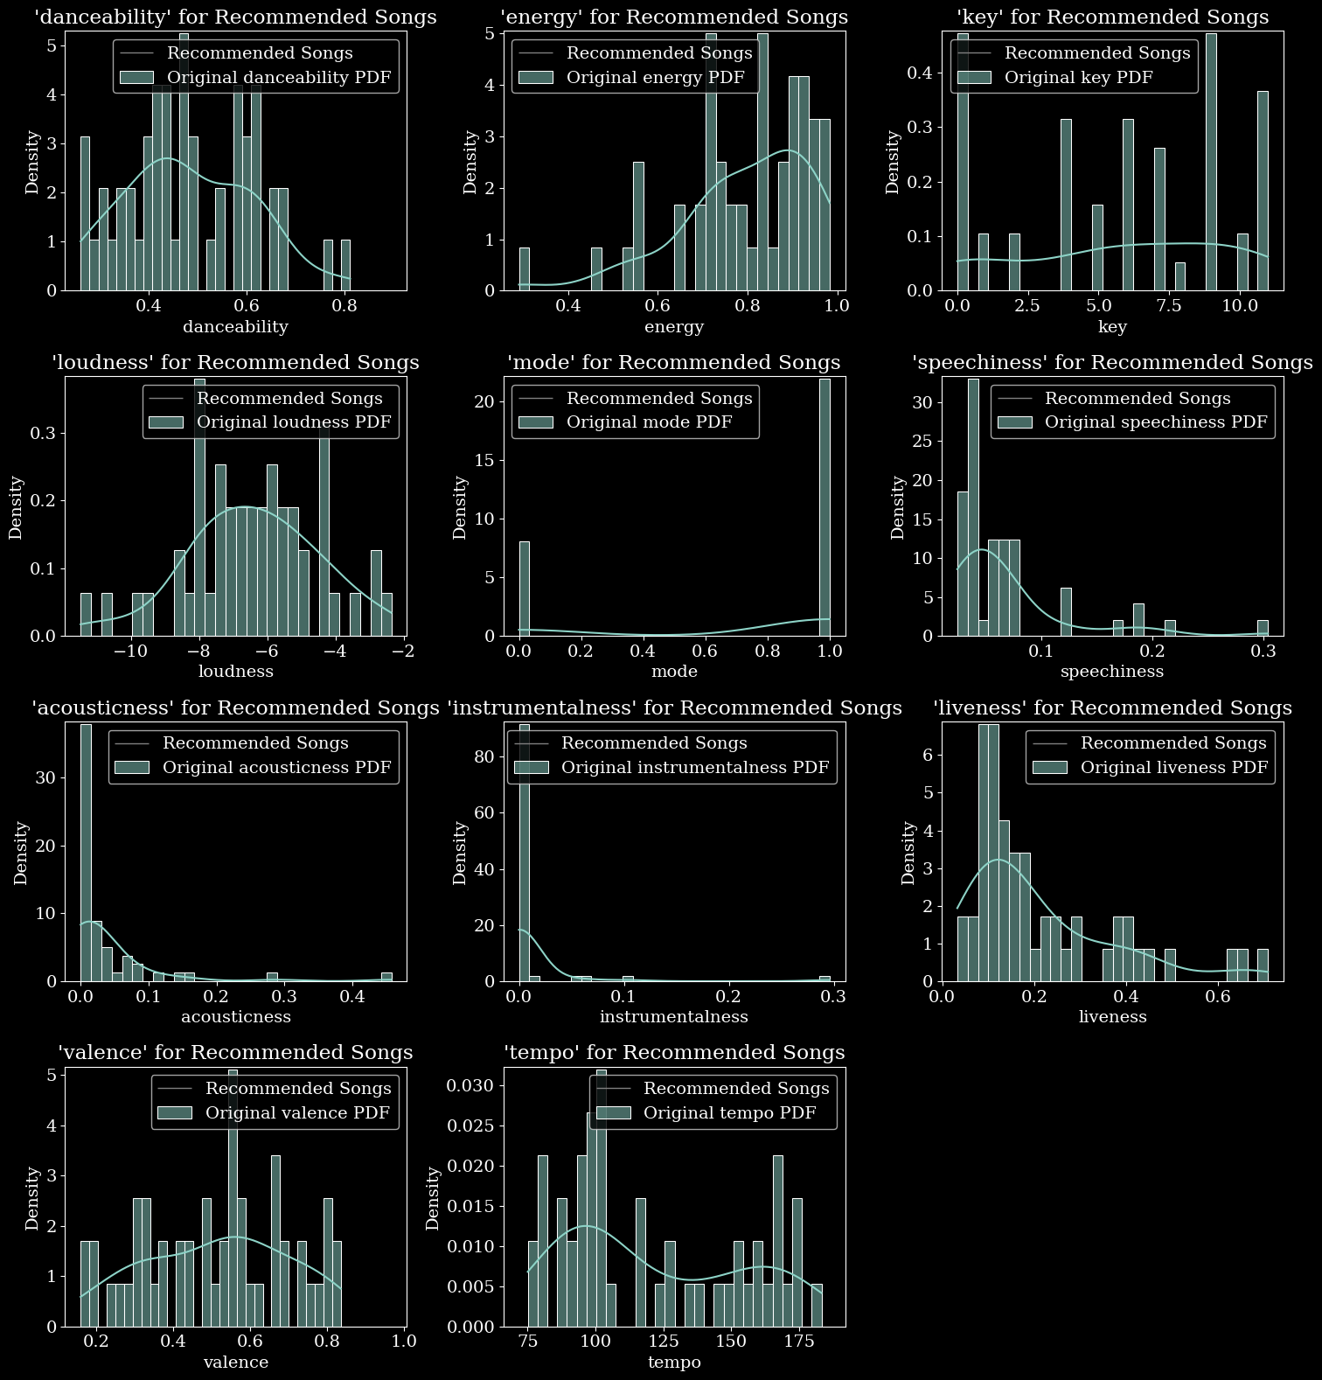
90’s Distributions

Slide 15
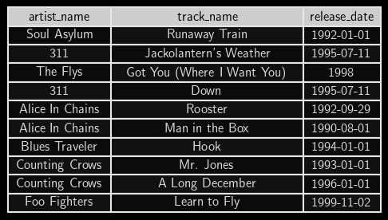
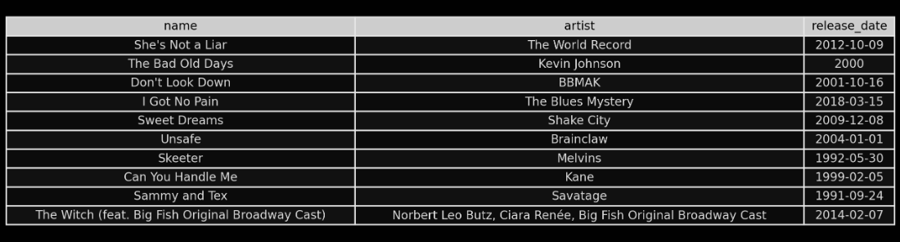
Sample of 90’s Playlist
Sample of 90’s Playlist Recommendations

Slide 16
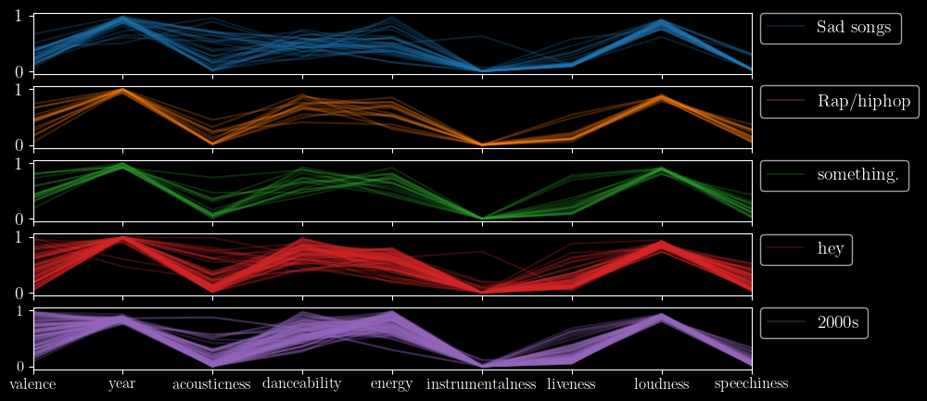
So… why isn’t it much better?

Slide 17


Matrix Factorization
User-Item matrices are used for recommender systems
Build a matrix R with playlists as rows, and songs for columns
Factor the matrix into two matrices, U and V

Slide 18
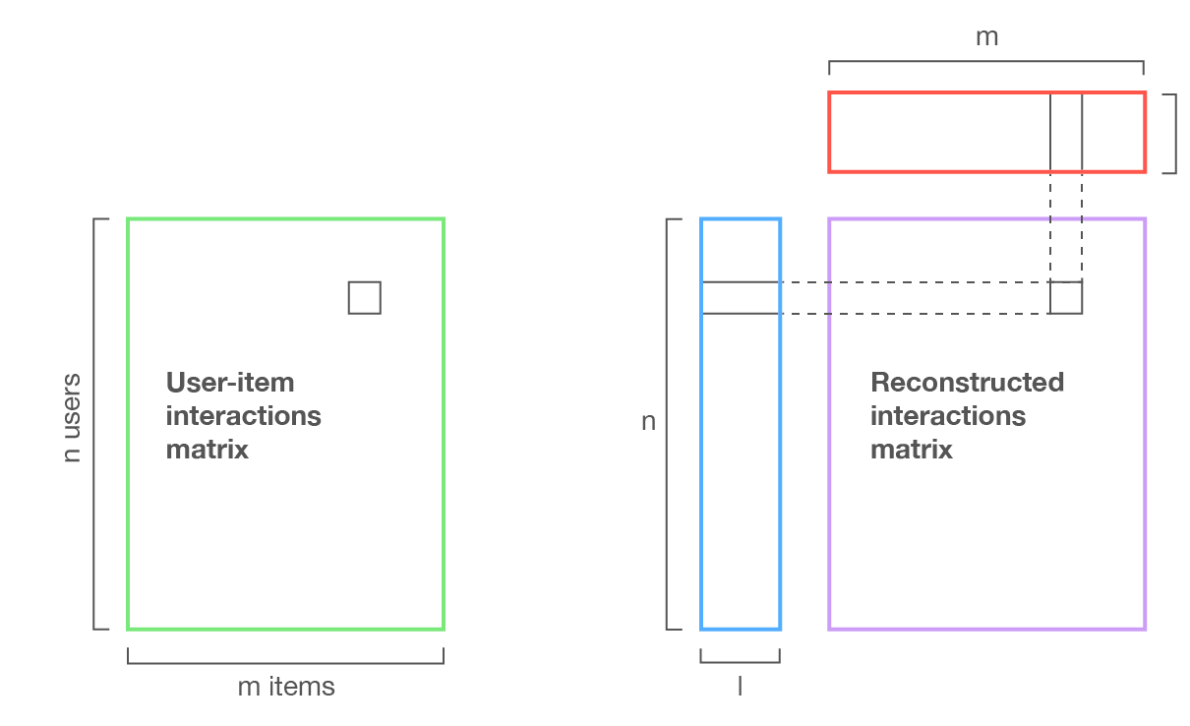
https://towardsdatascience.com/introduction-to-recommender-systems-6c66cf15ada

Slide 19
Collaborative Filtering
This is a process known as collaborative filtering
Does not rely on any provided features
Discovers “latent features” based on relationships between items and users

Slide 20
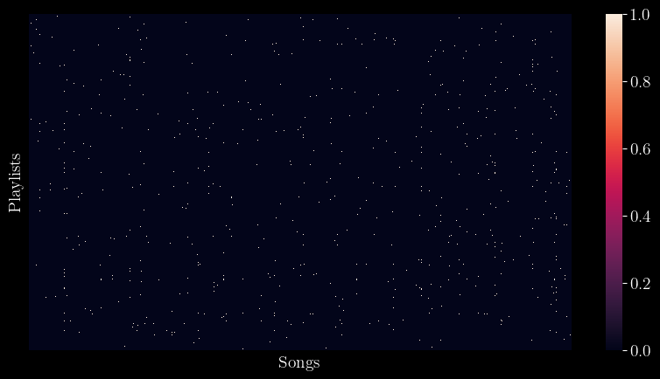
Sparsity
Most users have not listened to most songs
The resulting user-item matrix has
3,488 playlists
13,038 songs
45,476,544
99.73% of entries are zero

Slide 21
Scoring
R-Precision is listed as a metric of analysis in the Spotify Million Playlist Dataset Challenge
Remove 10% of the songs in each playlist as a “hold-out” set
Generate the reconstructed interaction matrix and see what percentage of the hold-out set is recommended (out of 20 recommendations)
Average across all playlists

Slide 22
How many latent features should we use?
Not enough features means the model won’t be able to find meaningful relationships between users and items
Too many features and the reconstructed interaction matrix will too closely approximate the user-item matrix we started with

Slide 23
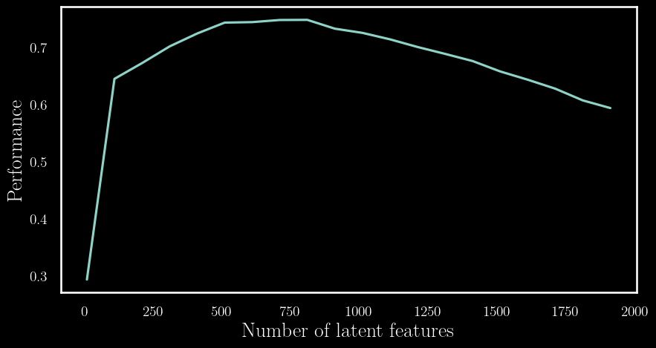

Slide 24
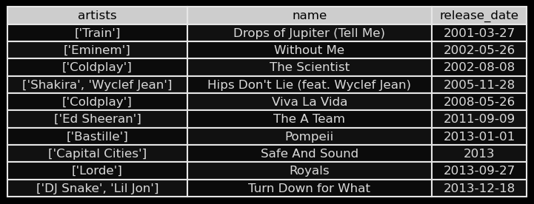
Sample of Gym Playlist
Sample of Gym Playlist Recommendations

Slide 25
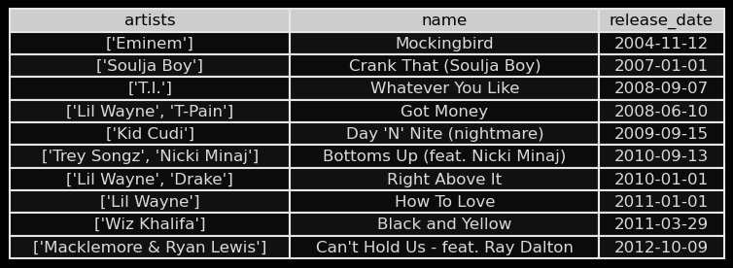
Sample of Rap Playlist
Sample of Rap Playlist Recommendations

Slide 26
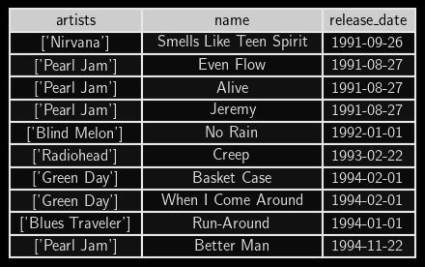
Sample of 90’s Playlist
Sample of 90’s Playlist Recommendations

Slide 27
Thank you!
Questions?

Slide 28
Links to data and resources
https://www.kaggle.com/datasets/rodolfofigueroa/spotify-12m-songs
https://www.aicrowd.com/challenges/spotify-million-playlist-dataset-challenge
https://developer.spotify.com/documentation/web-api/reference/get-audio-features
https://developers.google.com/machine-learning/recommendation/collaborative/matrix

